Slide 1

Chapter 2.3 Latent Factor Models

Slide 2
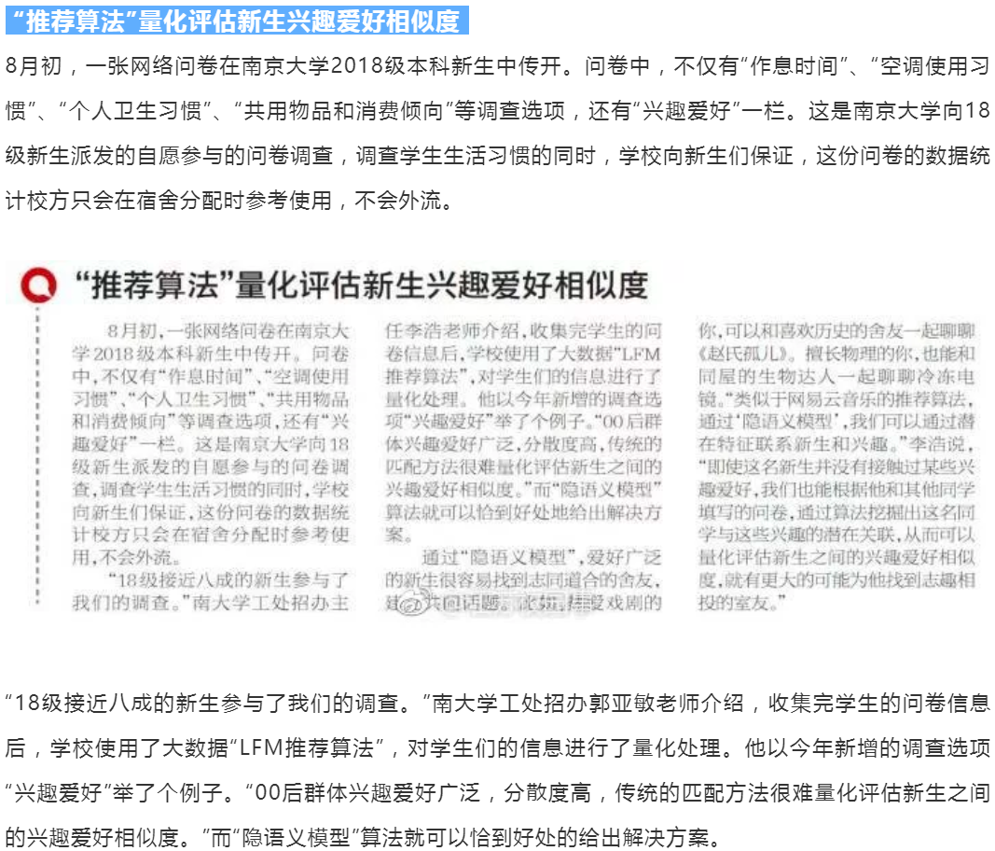
Notes:
https://mp.weixin.qq.com/s?__biz=MjM5NzA1MTcyMA==&mid=2651167881&idx=1&sn=f53ac4323a0089851c2e63d134b7a339&chksm=bd2ed0ae8a5959b84391a2c5885a537284e9ca9391ff0d0aaf33288d3ba2a07d813651c09f29&mpshare=1&scene=1&srcid=0825Q1K2TrUQ2LEoqlBWcCXc&sharer_sharetime=1575378209912&sharer_shareid=c97d86cd8de8ce5e369c723c9b205bcf&key=700431811b710b7ad8b600eba5dc2bc7afe42dcaa25afadf7f5452205217ec05cc6956a5055f8826e792713747e18d60315ad31d9b3f4b10581067e5cc8085a4e647de46cc9599b75011ac9c5f82873d&ascene=1&uin=MTcxMzI2MzA2MA%3D%3D&devicetype=Windows+7&version=62070158&lang=zh_CN&pass_ticket=7cqr39Q2l9NpFsKuTE365ZvJi9b81I5NG%2BxqHYpIDm6xk8xo%2BcBlZwnSK4Oy7z3i

Slide 3
Outline
Memory- vs. model-based methods
Singular value decomposition (SVD)
Matrix factorization (MF)
Tensor factorization (TF)

Slide 4
Memory-based approaches
User- and Item-based CF are "memory-based"
the rating matrix is directly used to find neighbors / make predictions
does not scale for most real-world scenarios
large e-commerce sites have tens of millions of users and millions of items

Slide 5
Model-based approaches
Model-based approaches
based on an offline pre-processing or "model-learning" phase
at run-time, only the learned model is used to make predictions
models are updated / re-trained periodically
large variety of techniques used
model-building and updating can be computationally expensive

Slide 6
Model-based approaches (2)
Many techniques have been proposed,
Cluster users and then recommend items the users in the cluster closest to the active user like.
Mine association rules (if-then rules) and then use the rules to recommend items.
Learning to rank: Logistic regression, neural networks (deep learning) and other machine learning methods.
Learn a latent factor model from the data and then use the discovered factors to find items with high ratings.
Costs of pre-processing
Usually not discussed
Incremental updates possible?

Slide 7
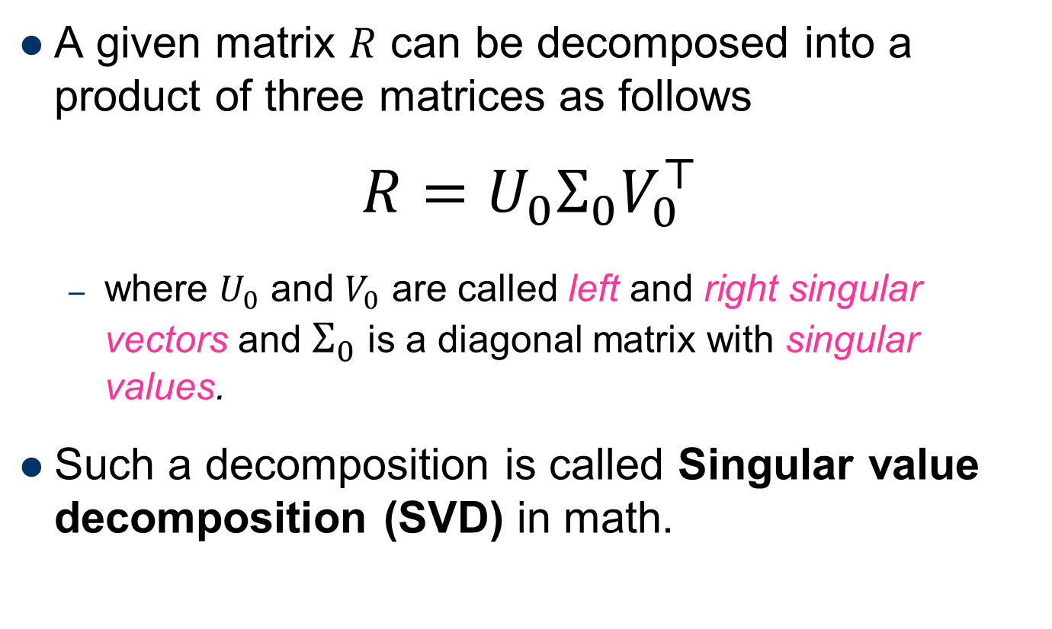
SVD: Singular Value Decomposition
A given matrix $R$ can be decomposed into a product of three matrices as follows
$$R=U_{0}Σ_{0}V_{0}^{⊤}$$
where $U_{0}$ and $V_{0}$ are called left and right singular vectors and $Σ_{0}$ is a diagonal matrix with singular values.
Such a decomposition is called Singular value decomposition (SVD) in math.

Slide 8
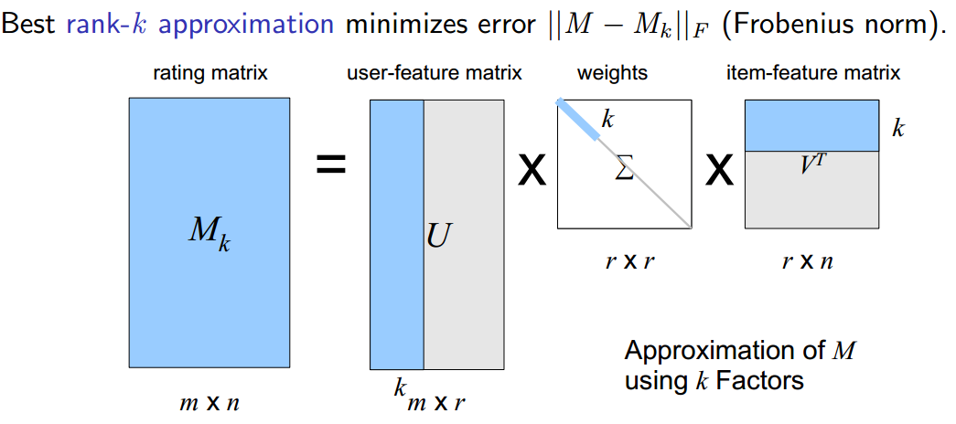
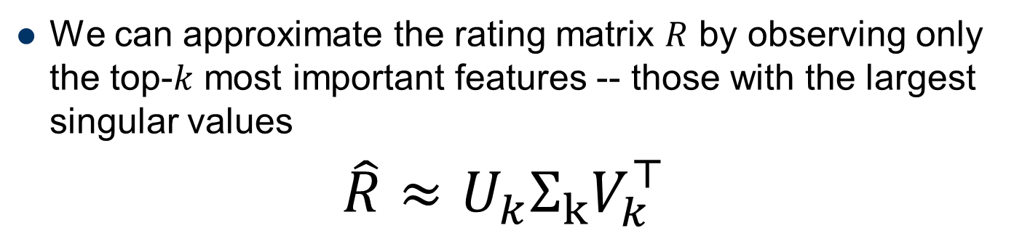
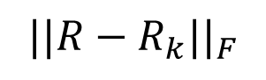
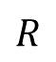
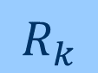
Singular Value Decomposition (2)
We can approximate the rating matrix $R$ by observing only the top-$k$ most important features -- those with the largest singular values
$$\hat{R}≈U_{k}Σ_{k}V_{k}^{⊤}$$
$$||R−R_{k}||_{F}$$
$$R_{k}$$
$$R$$

Slide 9
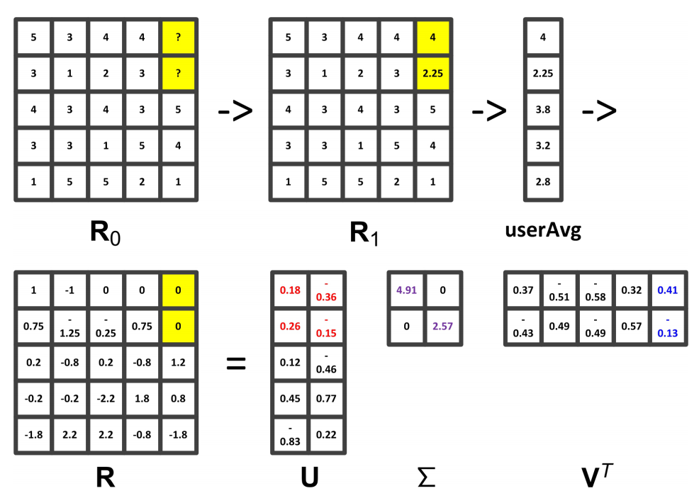
Singular Value Decomposition (3)
Notes:
Pure SVD can only operate on full, dense matrix.

Slide 10
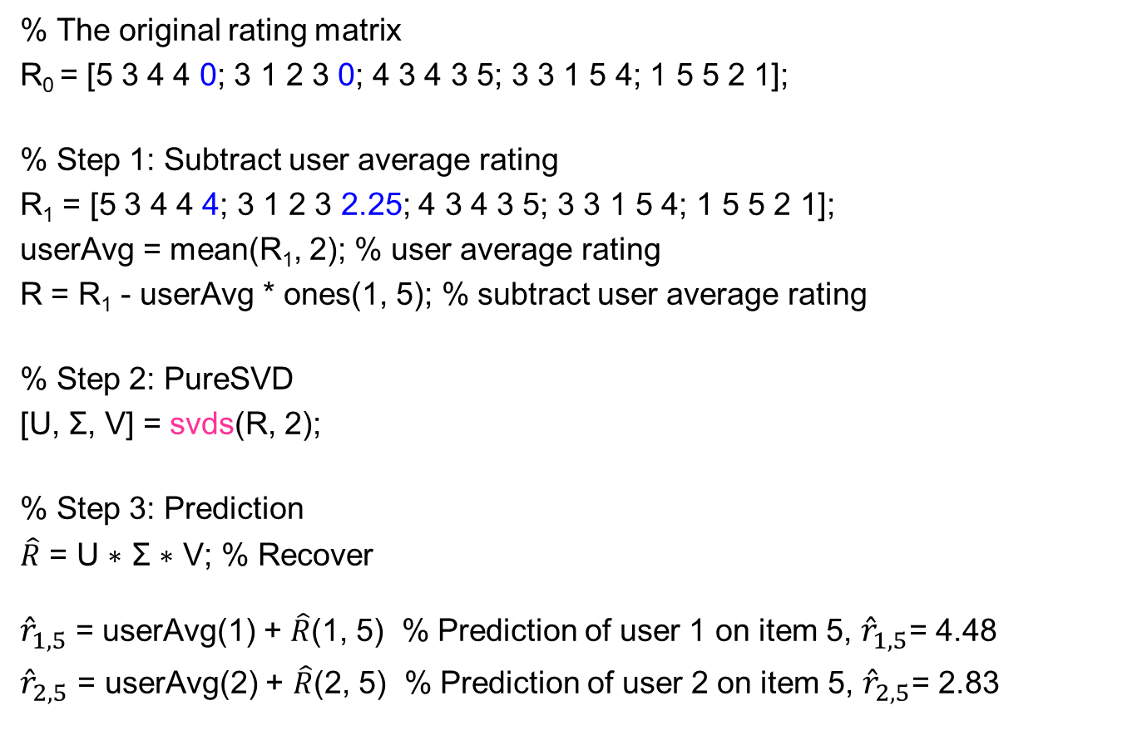
Singular Value Decomposition (4)
% The original rating matrix
R₀ = [5 3 4 4 0; 3 1 2 3 0; 4 3 4 3 5; 3 3 1 5 4; 1 5 5 2 1];
% Step 1: Subtract user average rating
R₁ = [5 3 4 4 4; 3 1 2 3 2.25; 4 3 4 3 5; 3 3 1 5 4; 1 5 5 2 1];
userAvg = mean(R₁, 2); % user average rating
R = R₁ - userAvg * ones(1, 5); % subtract user average rating
% Step 2: PureSVD
[U, Σ, V] = svds(R, 2);
% Step 3: Prediction
$\hat{R}$ = U ∗ Σ ∗ V; % Recover
${\hat{r}}_{1, 5}$= userAvg(1) + $\hat{R}$(1, 5) % Prediction of user 1 on item 5, ${\hat{r}}_{1, 5}$= 4.48
${\hat{r}}_{2, 5}$ = userAvg(2) + $\hat{R}$(2, 5) % Prediction of user 2 on item 5, ${\hat{r}}_{2, 5}$= 2.83
Notes:
Matlab codes

Slide 11
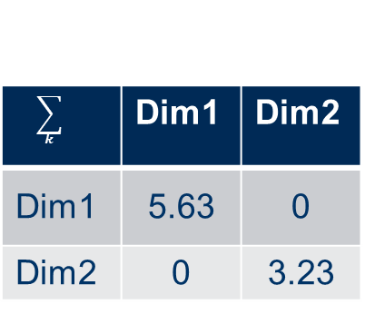
Example for SVD-based recommendation
SVD:
Terminator
Die Hard
Twins
Eat Pray Love
Pretty Woman
U_{k} | Dim1 | Dim2
Alice | 0.47 | -0.30
Bob | -0.44 | 0.23
Mary | 0.70 | -0.06
Sue | 0.31 | 0.93
V_{k}^{T}
Dim1 | -0.44 | -0.57 | 0.06 | 0.38 | 0.57
Dim2 | 0.58 | -0.66 | 0.26 | 0.18 | -0.36
$$\sum_{k}{}$$ | Dim1 | Dim2
Dim1 | 5.63 | 0
Dim2 | 0 | 3.23
Prediction:
= 3 + 0.84 = 3.84

Slide 12

The projection of $U$ and $V^{T}$ in the 2 dimensional space $(U_{2},V_{2}^{T})$
Sue
Terminator
Twins
Bob
Eat Pray Love
Mary
Alice
Pretty Woman
Die Hard

Slide 13
Singular Value Decomposition (5)
SVD for dimensionality reduction
Captures important factors/aspects and their weights in the data
factors can be genre, actors but also non-understandable ones
Assumption that k dimensions capture the signals and filter out noise (K = 20 to 100)
It’s very convenient to call a MATLAB function
Constant time to make recommendations

Slide 14
Singular Value Decomposition (6)
Limitations
It is difficult to call a MATLAB function in a real system
Filling the missing values with user average may not be optimal
It does not scale well to large data sets
Can we design an efficient and accurate matrix factorization based method?

Slide 15
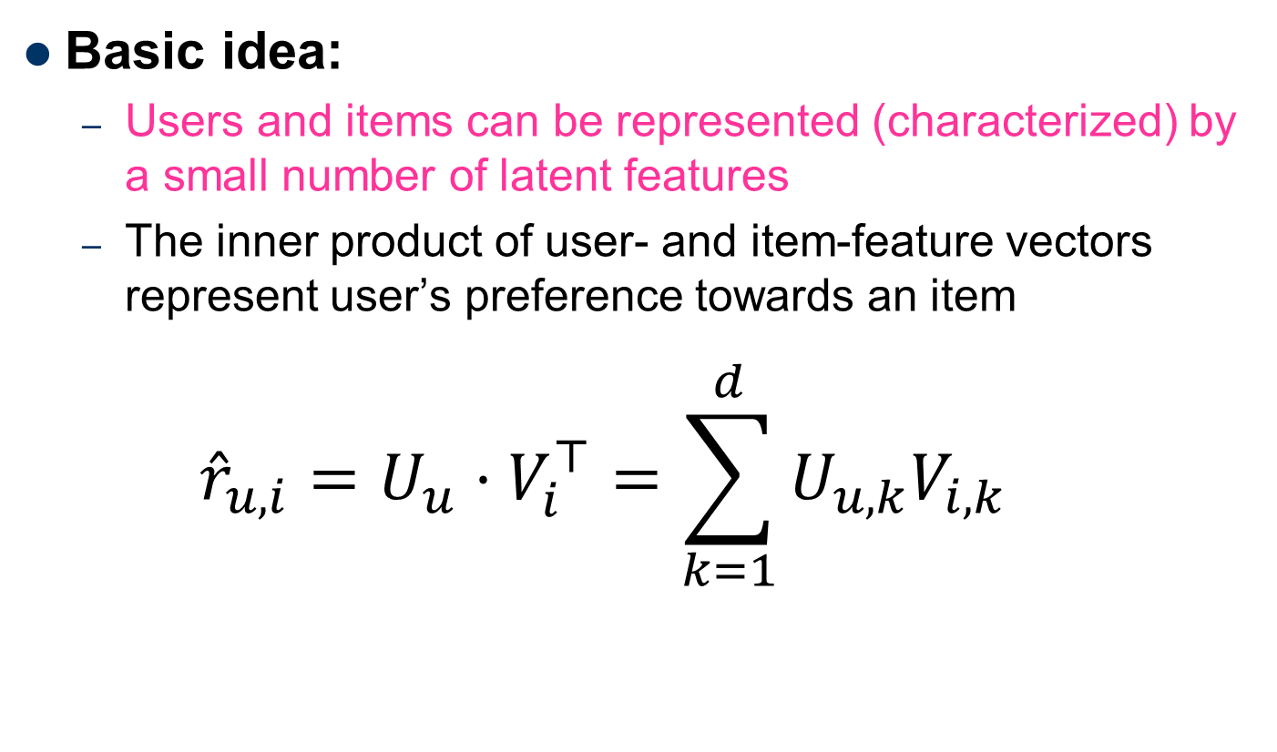
Matrix Factorization
Basic idea:
Users and items can be represented (characterized) by a small number of latent features
The inner product of user- and item-feature vectors represent user’s preference towards an item
$${\hat{r}}_{u, i}=U_{u}⋅V_{i}^{⊤}=\sum_{k=1}^{d}{U_{u,k}V_{i,k}}$$

Slide 16
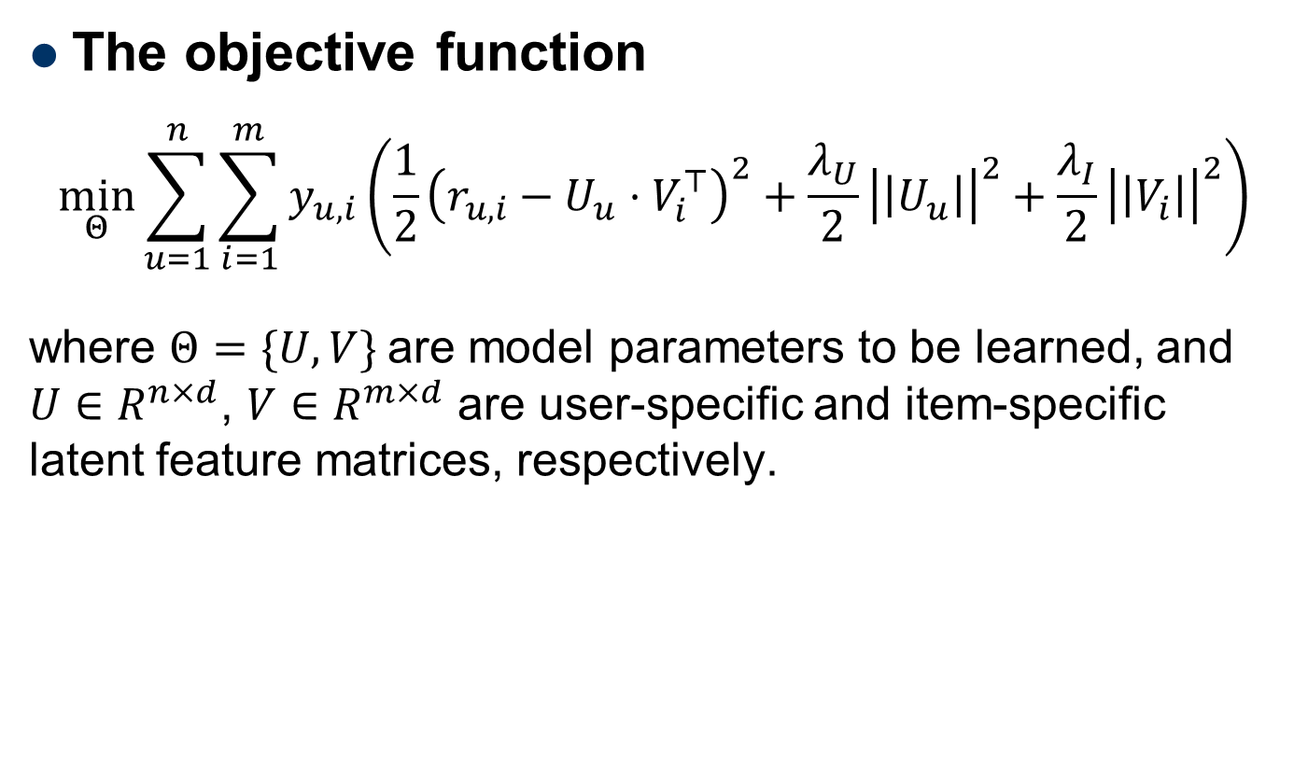
Matrix Factorization (2)
The objective function
$$\min_{Θ}{\sum_{u=1}^{n}{\sum_{i=1}^{m}{y_{u,i}\left(\frac{1}{2}{\left(r_{u,i}−U_{u}⋅V_{i}^{⊤}\right)}^{2}+\frac{λ_{U}}{2}{\left|\left|U_{u}\right|\right|}^{2}+\frac{λ_{I}}{2}{\left|\left|V_{i}\right|\right|}^{2}\right)}}}$$
where $Θ=\{U, V\}$are model parameters to be learned, and $U∈R^{n×d}$, $V∈R^{m×d}$ are user-specific and item-specific latent feature matrices, respectively.
Also called FunkSVD from Simon Funk’s post
http://sifter.org/~simon/journal/20061211.html

Slide 17
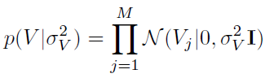
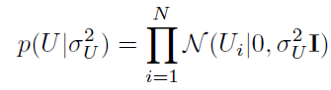
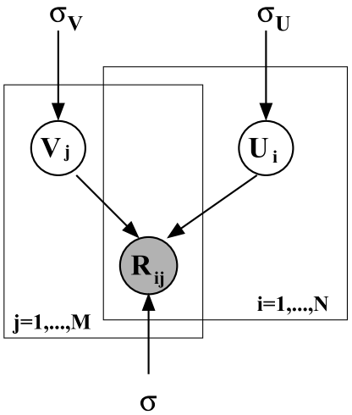
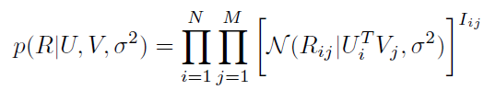
PMF: Probabilistic Matrix Factorization

Slide 18
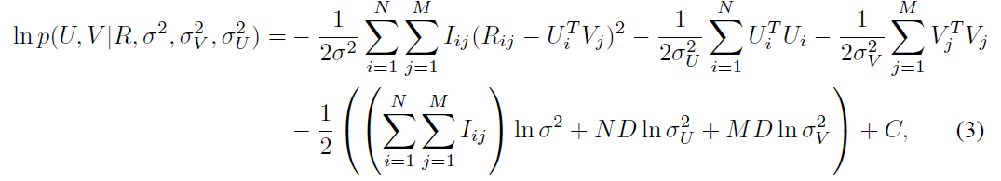
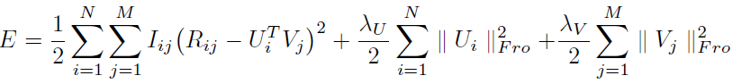
Probabilistic Matrix Factorization (2)
We want to maximize
Equivalent to minimizing
Can be solved using steepest descent method

Slide 19
Discussion
Matrix factorization
Generate low-rank approximation of matrix
Detection of latent factors
Projecting items and users in the same latent space
Prediction quality can increase as …
Filtering out some "noise" in the data and
Detecting nontrivial correlations in the data
Performance sensitivity
Number of singular values in the SVD approach
Parameters can be determined and fine-tuned only based on experiments in a certain domain

Slide 20
Gradient Descent Variants
Batch Gradient Descent
Calculate the gradients for the whole dataset to perform just one update
Learning rate (or step size): controls speed of convergence (or divergence if too large)
Cons: Very slow, no online updates
Stochastic Gradient Descent
Perform a parameter update for each user-item tuple (i, j)
Pros: cheap updates, online update, same practical convergence of Batch-GD
Cons: high variance (fluctuations), local minima
Minibatch SGD (not-covered)
Update every minibatch of n training tuples
Pros over SGD: less variance → stable convergence, fast matrix-ops

Slide 21
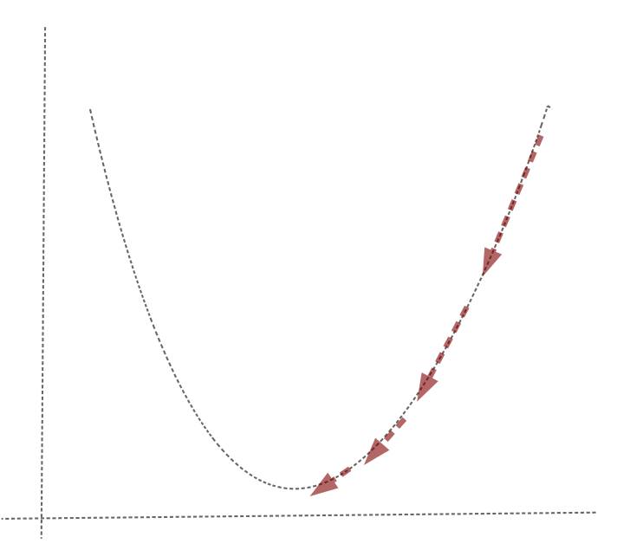
Learning: SGD

Slide 22
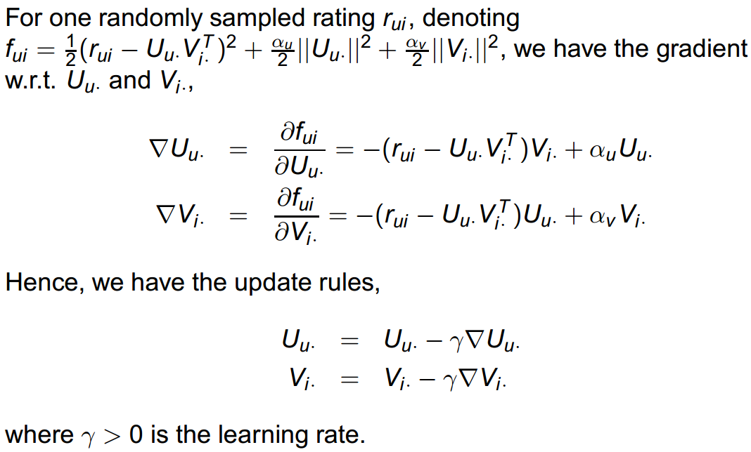
Matrix Factorization (3)
Stochastic Gradient Decent (SGD)

Slide 23
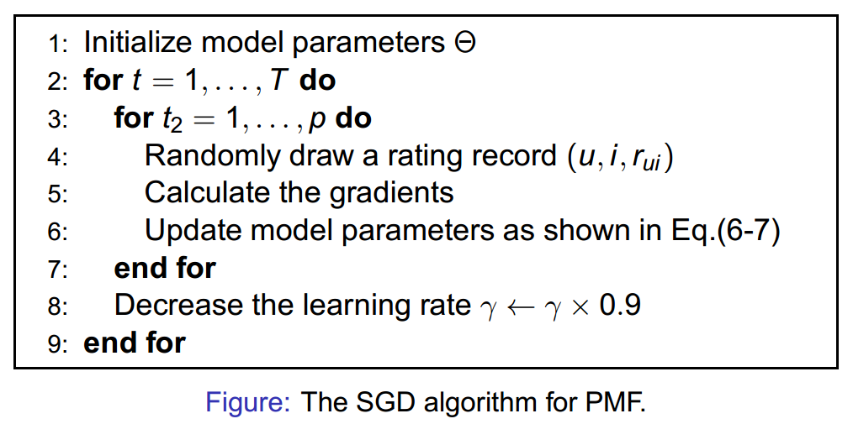
Matrix Factorization (4)
The learning algorithm
Random shuffle non-zero user-item pairs in R.

Slide 24
SGD Tips and Tricks
Tune the learning rate
Grid search with cross-validation
Reduce the learning rate over time with time decay
More sophisticated method (Adagrad, RmsProp,…)
Regularization factors play a big role
Tune them as well

Slide 25
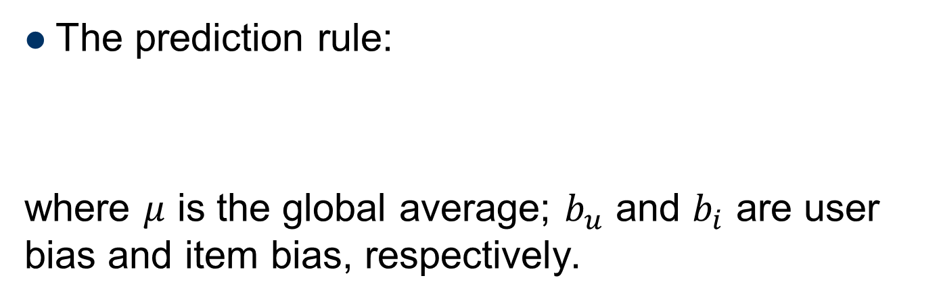
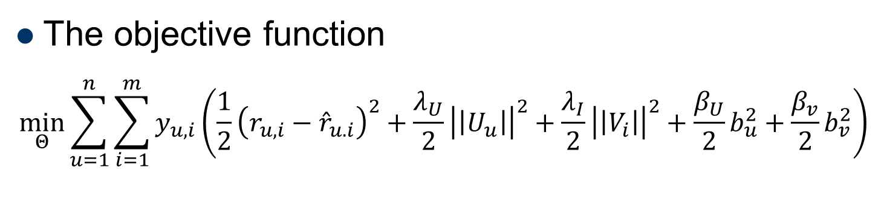
Biased MF
The prediction rule:
where $μ$ is the global average; $b_{u}$ and $b_{i}$ are user bias and item bias, respectively.
$${\hat{r}}_{u, i}=μ+b_{u}+b_{i}+U_{u}⋅V_{i}^{⊤}$$
The objective function
$$\min_{Θ}{\sum_{u=1}^{n}{\sum_{i=1}^{m}{y_{u,i}\left(\frac{1}{2}{\left(r_{u,i}−{\hat{r}}_{u. i}\right)}^{2}+\frac{λ_{U}}{2}{\left|\left|U_{u}\right|\right|}^{2}+\frac{λ_{I}}{2}{\left|\left|V_{i}\right|\right|}^{2}+\frac{β_{U}}{2}b_{u}^{2}+\frac{β_{v}}{2}b_{v}^{2}\right)}}}$$

Slide 26
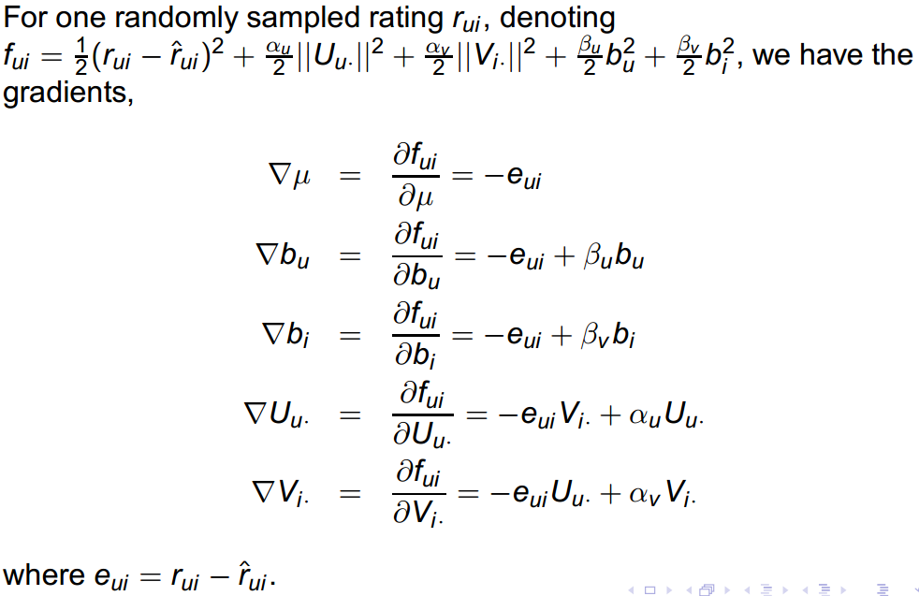
Biased MF (2)
Gradients

Slide 27
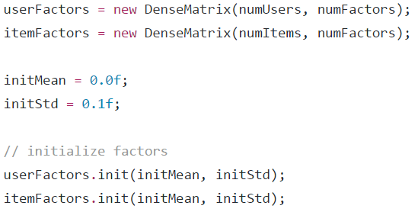
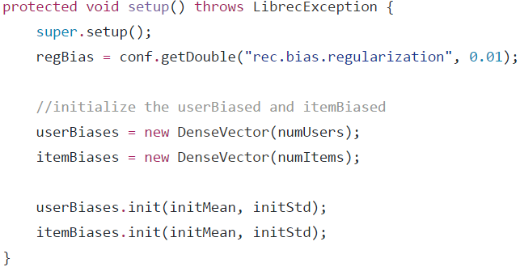
Biased MF (3)
BiasedMFRecommender
Initialization

Slide 28
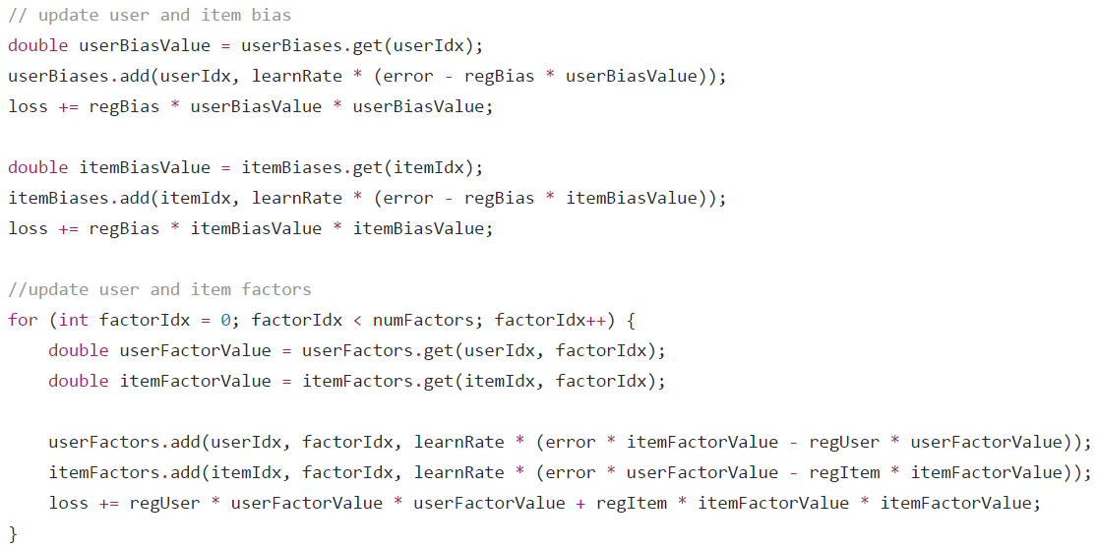
Biased MF (4)
BiasedMFRecommender
Model building

Slide 29
Biased MF (5)
BiasedMFRecommender
Performance on MovieLens (1M)
Algorithm | MAE | RMSE | Train | Test
GlobalAvg | 0.934 | 1.117 | 00:00 | 00:00
UserAvg | 0.829 | 1.036 | 00:00 | 00:00
ItemAvg | 0.782 | 0.980 | 00:00 | 03:06
UserKNN | 0.703 | 0.905 | 06:34 | 19:18
ItemKNN | 0.688 | 0.876 | 02:15 | 05:10
BiasedMF | 0.670 | 0.852 | 00:52 | 00:00
SVD++ | 0.668 | 0.852 | 02:45:03 | 00:00
http://www.librec.net/release/v1.3/example.html

Slide 30
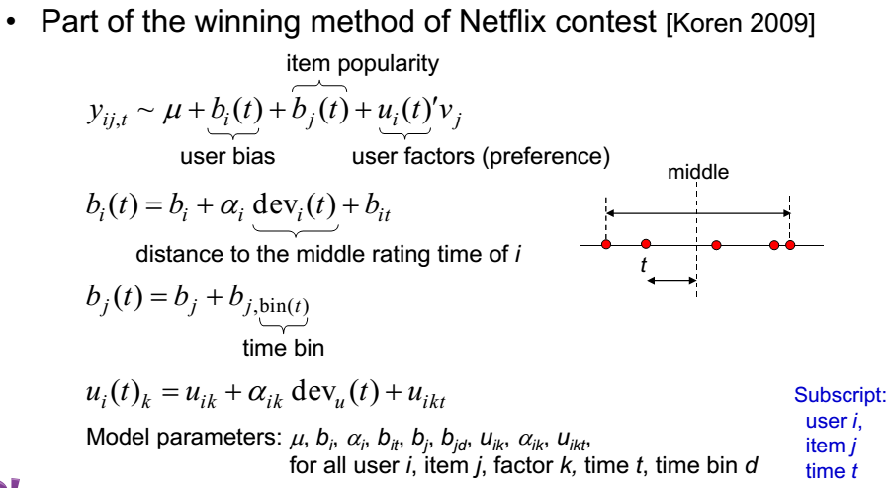
timeSVD++

Slide 31
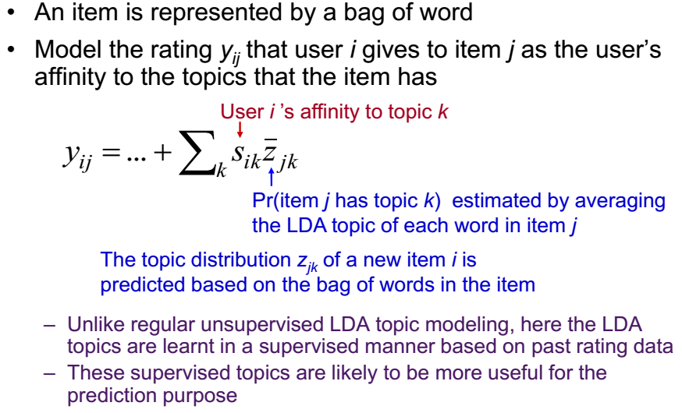
fLDA: Factorization through LDA Topic Model

Slide 32
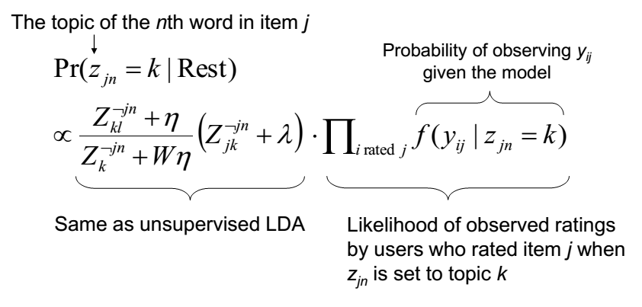
Supervised Topic Assignment

Slide 33
Reading Lists
Matrix factorization techniques for recommender systems; Yehuda Koren, Robert Bell and Chris Volinsky; https://datajobs.com/data-science-repo/Recommender-Systems-[Netflix].pdf
On the difficulty of evaluating baselines: a study on recommender systems; Steffen Rendle, Li Zhang, Yehuda Koren; https://arxiv.org/pdf/1905.01395.pdf
Matrix factorization: a simple tutorial and implementation in Python; Albert Au Yeung; http://www.albertauyeung.com/post/python-matrix-factorization/

Slide 34
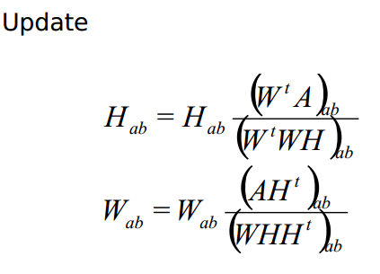
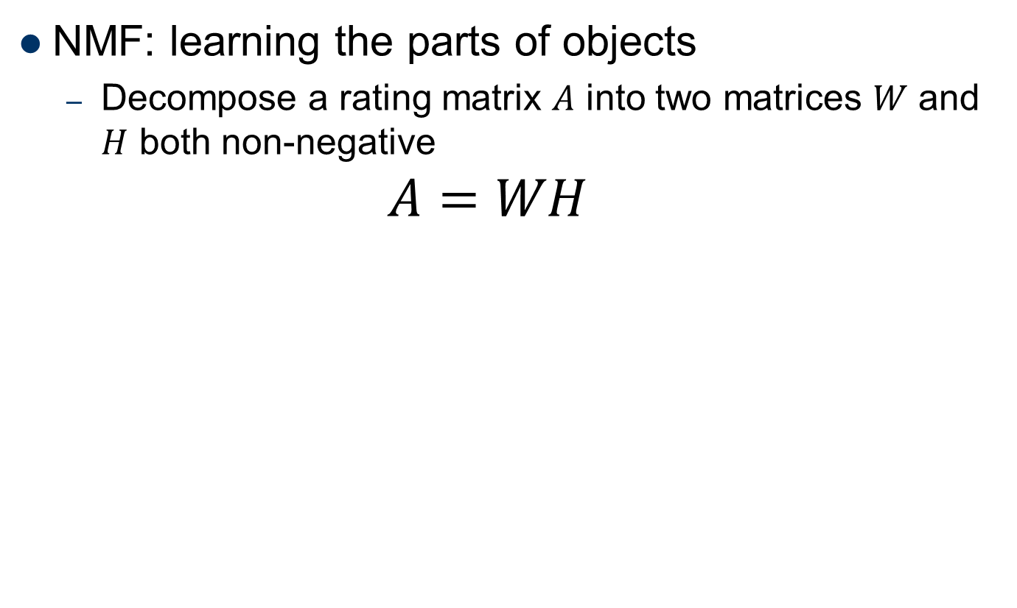
NMF: Non-negative MF
NMF: learning the parts of objects
Decompose a rating matrix $A$ into two matrices $W$ and $H$ both non-negative
$$A=WH$$

Slide 35
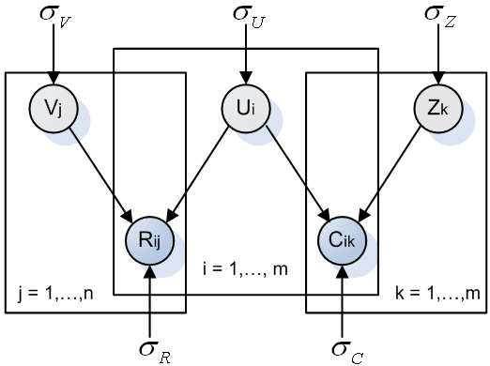
Extension to PMF
We can augment the model as long as we have additional data matrix that share comment latent feature matrix

